Slide 1
Welcome to PIC16A!
Professor Michael Perlmutter
UCLA Department of Mathematics

Slide 2
Guiding Principles
We want you to succeed.
None of us signed up for this.
Your wellbeing comes first.
We’ve got your back.

Slide 3

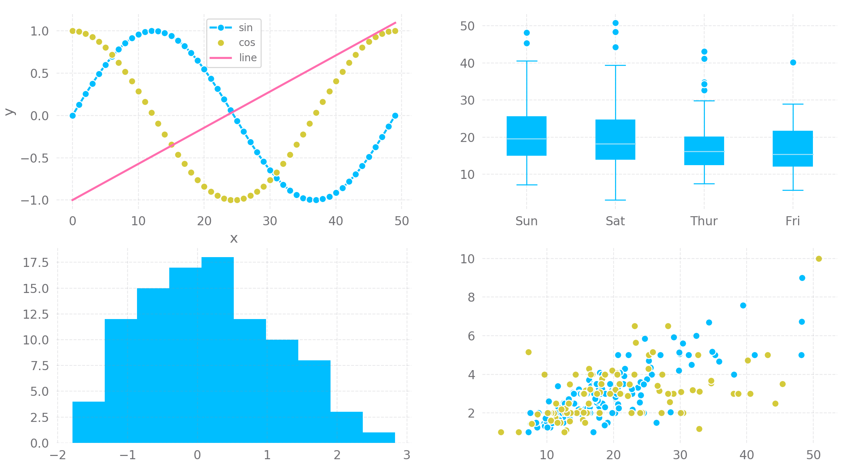
In PIC16A
Python basics
Python for (data) science

Slide 4
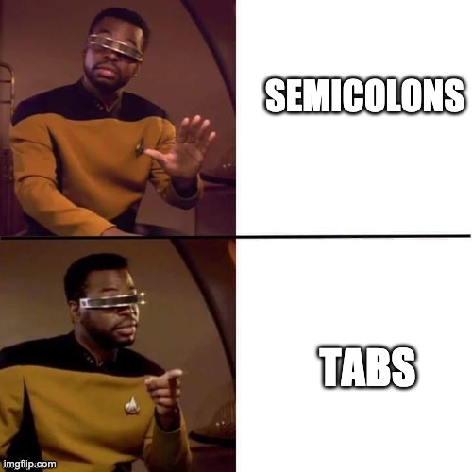
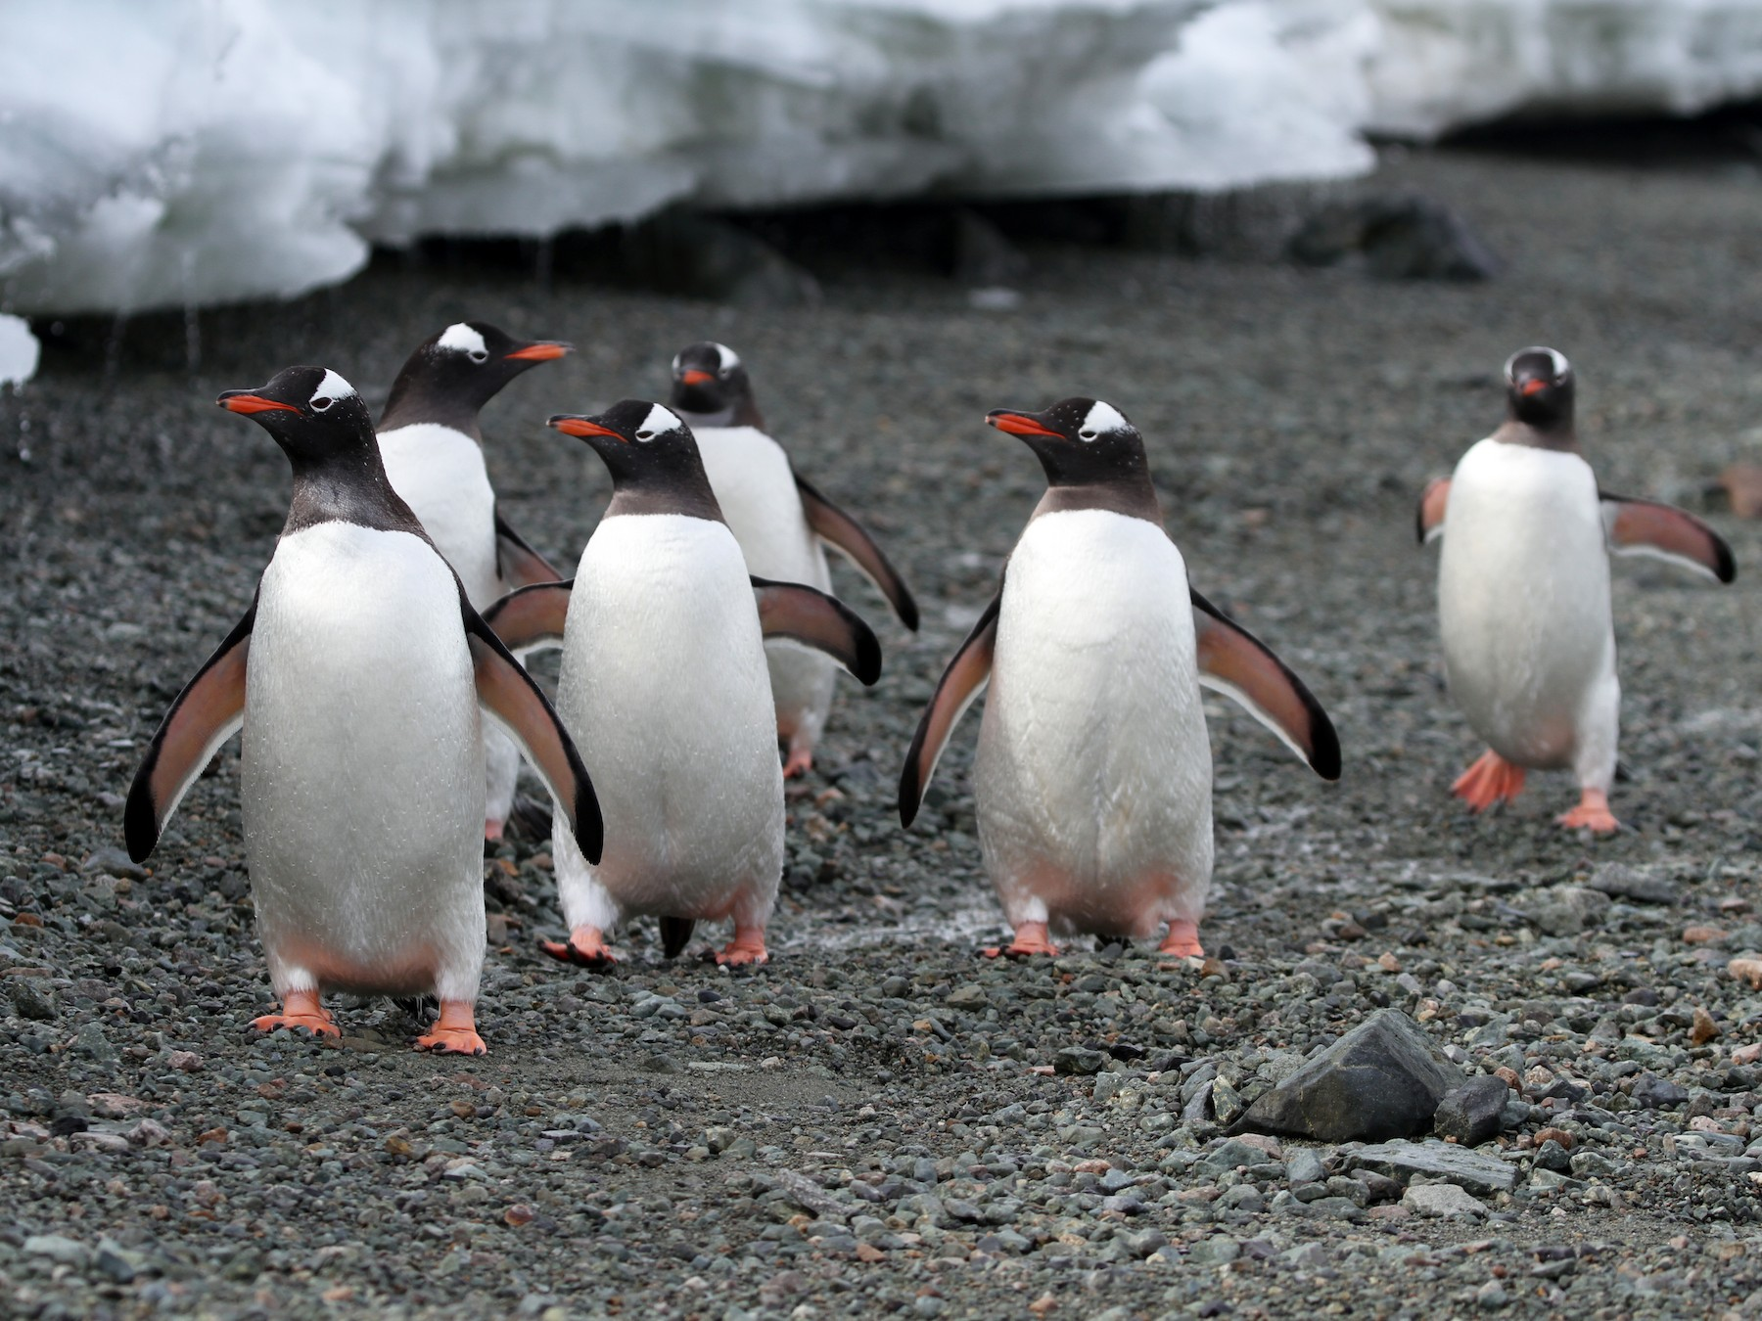
Also in PIC16A
Memes
Penguins

Slide 5

Flipped Classroom
All required content is pre-recorded and posted on CCLE.
Attendance at MW lectures is encouraged.
Review
Questions from forum / quizzes
Supplementary content
Activities
Attendance at TuTh discussions is required (except for timezone exemptions).

Slide 6
Course Format - Promote Active Learning
Prerecorded videos
Approximately one lecture worth of material posted three times a week – Quiz due at 11:59
Live Lecture
Twice a week, Monday and Wendesday, clarify material from Prerecorded Videos
Post questions in advance (campuswire, on CCLE, email)
Discussion Section – Twice a week Tuesday and Thursday
Structured group work, rotate between here different roles
Part of your participation grade

Slide 7
Participation
(aka Working in Groups)

Slide 8
Participation in PIC16A
Attend Discussion (required) and work with your group on programming activities.
Groups are created based on interest and time zones Please fill out the questionairre if you haven’t already
Timezone exemptions: you will agree with your group on an alternate time to complete the activity.
Activities are submitted for a participation grade.

Slide 9

Coding in Groups
Review “Working in Groups” on CCLE.
Based on the pair programming paradigm.
A Driver, who types the code and turns in the assignment.
A Proposer, who suggests solutions and high-level approaches to problems.
A Reviewer, who offers constructive criticism on the Proposer’s suggestions and the Driver’s code implementation.

Slide 10
Norms for Group Work
Do the lecture and readings ahead of time.
Arrive on time.
Cameras on in breakout rooms, please.
Attending in pajamas, from bed, with tea, with food etc. is fine as long as you are ready to participate.
Pet cameos are highly encouraged.

Slide 11
Course Rubric
Homework | 20%
Participation | 20%
Quizzes | 10%
Mini-Project | 10%
Midterm | 15%
Final | 25%

Slide 12
Course Team
Instructor: Michael Perlmutter TA: Kirill Gura
LAs:
Carolyn Ta
Adriel Friedlender
Leadership: Jacob Kaufman

Slide 13
BREAK TIME
(2 minutes)

Slide 14
Getting Help

Slide 15
Campuswire
Link on CCLE (under Site Info)
Email me if you have problems joining.
Suggested usage:
Ask/answer questions.
Communicate with your group in chatrooms.
DM me or Kirill.
Warning: we may ask you to post your question.
I may be faster to reply over email.

Slide 16
Office Hours
Prof. Perlmutter:
TBA.
Kirill:
TBA
0.25% extra credit the first time you ask a question in OH.
You are also welcome to come listen, work on your HW, chat...

Slide 17
Other Policies and Resources

Slide 18
Course Environment
Discrimination on the basis of ethnicity, race, gender, sexual orientation, ability, age, religion, etc. is not tolerated in my classroom.
Title IX: you deserve a learning environment free from discrimination, sexual harassment, sexual assault, and stalking. If you experience these behaviors, the UCLA Title IX Office can help.
I am a mandatory reporter. Confidential resources are also available

Slide 19
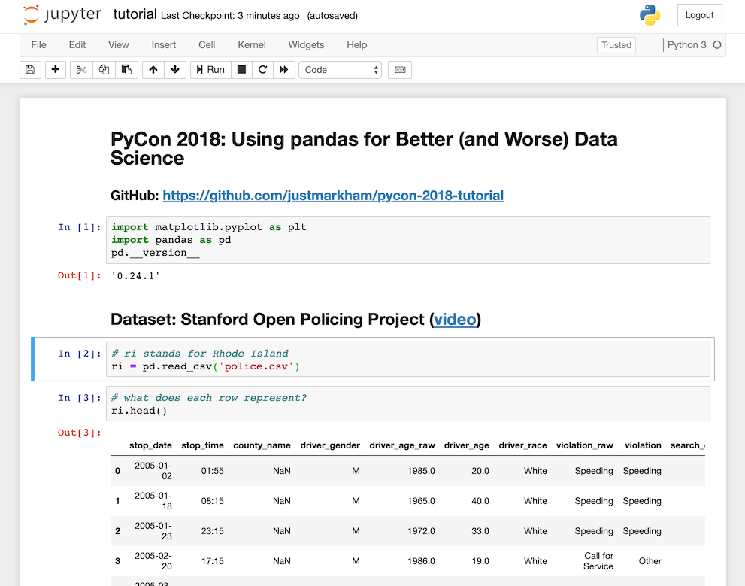
Assignments
Complete in Jupyter
Convert to PDF
Submit PDF
Review “Expectations for Assignments” on CCLE.

Slide 20
Lots of Drops, No Extensions
HW: 2 out of ~8 dropped.
Discussion: 4 out of ~20 dropped.
Quizzes: 5 out of ~30 dropped.
I will generally expect you to use your drops, and will not grant extensions on individual assignments.
If you expect to miss multiple weeks worth of work, then contact me ASAP and we’ll find a path.

Slide 21
Extra Credit Opportunities
Post on Campuswire (up to 1%)
Awarded for both excellent questions and excellent answers.
Feedback Surveys (0.25% each)
Two throughout the quarter.
Essay on societal impact of data science (up to 3%)
900-1200 words
At least five sources.
Coherent argument with thesis statement + evidence.
See Syllabus for rubric.

Slide 22
Collaboration
Do it! List your collaborators on your assignments.
Do share: ideas, concepts, useful references, examples, hints.
Do not share: solution code.
Quizzes & exams are solo (but open book + notes).

Slide 23
Everyone can get an A
Assignments + exams will be graded fairly strictly. However:
I will tell you what kind of output I am looking for.
I will tell you my expectations for your code structure/style.
To score well:
Plan ahead.
Work hard.
Try multiple approaches.
Get help.
You are NOT competing against each other
We are all on the same team

Slide 24
Guiding Principles
We want you to succeed.
None of us signed up for this.
Your wellbeing comes first.
We’ve got your back.
Let’s have fun and do cool stuff.

Slide 25

Thanks!
Questions?

Slide 26
Acknowledgements
Much of the format of this class is based on Phil Chodrow’s class from last quarter
Phil and I are coordinating resources this quarter
Covering same content on same days
Most of the same HWs and discussions

